Slide 1
Biblical Mentorship

Slide 2
Proverbs 9:9 “Instruct the wise and they will be wiser still; teach the righteous and they will add to their learning.”

Slide 3
Proverbs 27:17 “As iron sharpens iron, so one person
sharpens another.”

Slide 4
I Thessalonians 2:8 “Because we loved you so much, we were delighted to share with you not only the gospel of God but our lives as well.”

Slide 5
Philippians 4:9 “Whatever you have learned or received or heard from me, or seen in me—put it into practice. And the God of peace will be with you.”

Slide 6
Hebrews 13:7 “Remember your leaders, who spoke the word of God to you. Consider the outcome of their way of life and imitate their faith.”

Slide 7
Purpose
To Identify the Biblical Basis for mentoring, putting this into practice in our own lives, and recognize how to train others to make this a reality in their lives as well.

Slide 8
“You’ve all drunk too much; you’ve become obsessed
with the youthful spirit, and you actually imagine that youth will save the church. It is no wonder you feel like you’re struggling with faith and its formation; you’ve given your attention to the cultural benefits of an age group over concern for the working of the Holy Spirit, who is the very giver of that which you seek.” -- Bonhoeffer

Slide 9
Connect
Take a few minutes to make a list of people who have been influential during different seasons of your life. Fill in a name for each
of the eras, identifying who they were and what you learned from them:

Slide 10
Click the icon to watch video

Slide 11
The journey to a spiritually vital church must begin within your own heart. After that, you can explore and implement …best-practice strategies you’ve read about and pursue insights inspired by the other research findings. But if you get that order reversed— relying on strategies before working on your heart— beware. You cannot reproduce in others what you are not producing in yourself. The main thing you need to do— the one thing you must do— is fully within your reach. You must surrender all. Everything.
Hawkins, Greg L.; Parkinson, Cally (2011-08-12). Move: What 1,000 Churches Reveal about Spiritual Growth (Kindle Locations 4035-4039). Zondervan. Kindle Edition.

Slide 12
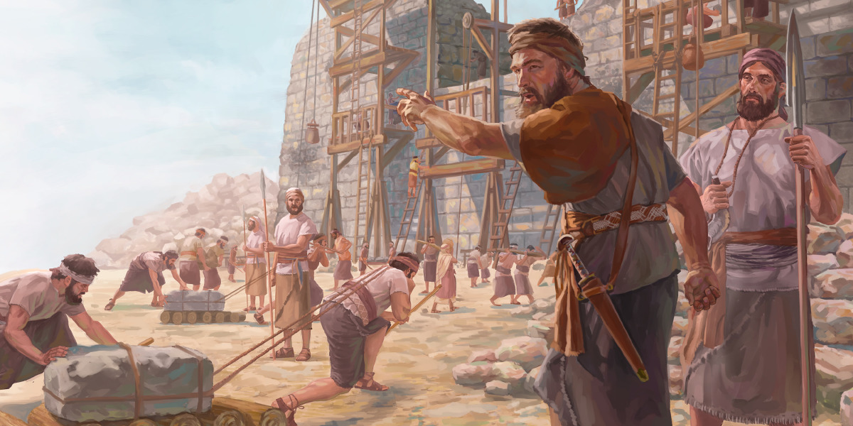
Biblical mentorship in every story of the Bible

Slide 13
1. Great leaders should take time to pray.

Slide 15
2. Spiritual leaders take things step by step.

Slide 16
Divine Mentor
Find the help you need when difficult tests come
Walk with both the heroes and the fools of the Bible
Start thinking like God thinks, so you can respond as God responds
Avoid costly errors and so avoid decades of misery

Slide 17
Sacred Space
“Will we choose to spend quiet, reflective time alone with the Lord? Or will we allow life’s pressures to work us into a frazzle?
Will we build a sacred enclosure around our roots, or will we allow frenzied foot traffic to erode our spiritual roots and send us crashing to the earth?” (Loc. 257)

Slide 18
“Our shortage of wisdom keeps us seeking Him and prevents us from becoming hardhearted. It keeps us humble, malleable, correctable, changeable, and transformable, so that with each new day we might increasingly reflect His image.” (Loc. 347)

Slide 19
“If Consequences has a back-end price, Wisdom has a front-end price. It requires discipline, obedience, consistency, and above all else, time. Then it gladly pours on you its promised tremendous riches.” (Loc 392)

Slide 20
“Only you can keep yourself spiritually healthy by feeding yourself. No one can do it for you by proxy.” (Loc 561)

Slide 21
“Neglecting devotions will cause you more problems, more quickly, than just about anything you can name. Spending unrushed time alone with God in His Word releases a fountain of refreshment from the very core of your being.” (Loc 739)

Slide 22
How to Listen to God’s Voice
Daily Devotions
“When you miss your devotions one day, you notice. When you miss them two days, your spouse and kids notice. And when you miss them three days, the world notices.” (Loc 978)

Slide 23
Securing your devotion
Scripture
Observation
Application
Prayer

Slide 24
Securing your devotion
Bring your daily planner
The 20/20/20 program
Discipleship
Public Spot
How Big?

Slide 25
Delighting in God’s Word
The Bible is the Only Book God ever promised to inspire
The Bible is the Only Book where all the Divine
Mentors are present
God promises specifically to bless the readers of the Bible
The Bible is the Only Book that will live forever

Slide 26
The University of the Holy Spirit
Not a program but a process
The invitation is ours to accept or deny

Slide 27
Philippians 1-3

Slide 28
CONSOLIDATE
Take 20 minutes and read Philippians 1-3. While reading, ask God to reveal something to you from this section of Scripture.
Next, take 20 minutes to journal on this passage.
Scripture: Which portion of the scripture spoke to you? It could be one verse, or several. Write them out.
Observation: What is it that you observed in this verse or verses?
Application: What is it that you have learned from this verse or verses and how does it apply to your life today?
Prayer: What should you pray for, considering what you have learned from the Scripture.
Come back together as a group and report what it is that the Lord said to you through the passage. Give opportunity for each person to report.

Slide 29
CHANGE
What do you feel that you have learned from this lesson today?
How has what we have learned apply to your ministry situation?
Now that you have practiced how to use the Scriptures as your Divine Mentor, I encourage you to make a commitment to try out this practice for the next 30 days.
Ask God to help you put this into practice in yourlife.

