Slide 1
BASIC ELEMENTS OF ACCOMPANIMENT IN MENTORSHIP
PRESENTED BY JOHN HAINES

Slide 2
MENTORS OF MANY ‘TYPES’
Sunday school teachers
Family members
Pastors and other spiritual leaders
Never forget…there is a third Person in every mentor-mentee relationship: God, the Holy Spirit!

Slide 3
MY STORY
Age 8: Miss Dietrich, my Sunday school teacher (aged 88)
Prayer
Age 8 and beyond: My grandparents
Study and application of the Scriptures
Age 9 and beyond: My pastor(s)
Practice of ministry

Slide 4
WHAT IS ‘MENTORSHIP’?
Mentorship is the process of coming alongside another person or persons in order to help them develop, mature, and ‘become’:
Knowledge, understanding, gifts, graces, and skills

Slide 5
v
The Mentor
Already on a journey of development
Possesses knowledge and understanding
Continues to develop gifts, graces, and skills

Slide 6
MENTORSHIP IS NOT A ONE-WAY ENGAGEMENT
In Education we say: Every teacher must first be a learner; and every student can be a teacher!
Modeling: not for exact replication, but for effective, relevant, and transformative next-generation application of core principles of a Christlike life.

Slide 7
DIALOGUE
Anti-dialogue = A over B, issuing ‘communiques’ (orders, instructions)
Real dialogue = A with B, in real communion and communication as they walk the road together

Slide 8
CONNECT
Living a ‘confessional life’ together
“Keep short accounts with God and men [people]…for without a willing spirit of confession, holiness is blocked from view, or proven untrue to others!”

Slide 9
CONFESSIONAL LIFE AND RIGHTEOUSNESS
The restoration of the Imago Dei (Image of God):
Right relationship with God
Right relationship with others
Right relationship with creation
Right relationship with myself

Slide 10
CONTENT, MENTORING IS:
A human interchange, lived out in covenantal relationship and mutual respect…often long-term, and built upon a principle of ‘accompaniment’ (side-by-side relationship or covenantal living) for the long road

Slide 11
CONTENT, MENTORING IS NOT:
Discipleship: ALL Christians are to be disciples making disciples (middle persons)
Coaching: A trained approach to help others learn how to ask the right questions in order to reach the right answers to take the right actions

Slide 12
ACTIVITY-PERSONAL
On a piece of paper, write the name of the person who has had the most influence on your spiritual life.
Then, write the traits that gave them significance in your life.
Then, create a list of traits that you believe help to make an “Ideal Mentor.”

Slide 13
ACTIVITY-SMALL GROUP
Draw your “Ideal Mentor” on a large poster:
Collaborate to share your ‘traits’ (written individually)
(Example: good listener-draw big ears on your ‘ideal mentor’; prayerful-draw praying hands, etc.)

Slide 14
BREAK
AND CONTINUE WITH YOUR IDEAL MENTOR

Slide 15
A RABBINIC ILLUSTRATION
The first day of school (Synagogue) during intertestamental and New Testament Age
Note each of the components in this first encounter between Rabbi and student

Slide 16
UNDERSTANDING THE ILLUSTRATION
This first encounter is one of ‘Mystery in the meeting:
“Mystery is not that about which we cannot know anything, but that about which we cannot know everything.”
- Maria Harris

Slide 17
ENCOUNTERING ‘MYSTERY’
The rabbi kneels…honoring the one he does not fully know.

Slide 18
ENCOUNTERING ‘MYSTERY’
Eye to eye…deep honesty between two pilgrims.

Slide 19
ENCOUNTERING ‘MYSTERY’
“I covenant to teach you by living” …personal investment for the sake of another.

Slide 20
ENCOUNTERING ‘MYSTERY’
The rabbi blesses and prays…becomes a middle figure in life.

Slide 21
ENCOUNTERING ‘MYSTERY’
The rabbi embraces (heart to heart)…acceptance of another without guarantees of results.

Slide 22
ENCOUNTERING ‘MYSTERY’
The rabbi welcomes and encourages…lifelong engagement in a process bigger than either the rabbi or his student

Slide 23
IMAGINE JESUS AND HIS RABBI
Close your eyes, picture yourself there, observing this encounter.
Feel the exchange.
Understand the principles.

Slide 24
SPIRITUAL FORMATION AND MENTORSHIP
“Spiritual formation is the process of being conformed to the image of Christ for the sake of others.”
- Robert Mulholland

Slide 25
A SCRIPTURAL INSIGHT FOR MENTORING
John 16:5-16 The Role of the Holy Spirit as Guide (3 Roles)
The ’mentor’ has a Spirit-filled responsibility to do for others what is mapped out in this passage!

Slide 26
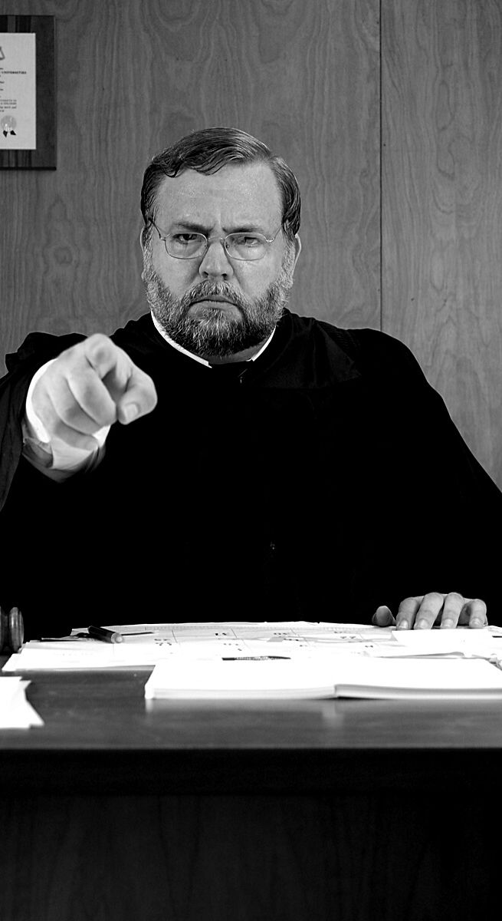
ROLE 1: TO ‘CONVICT’ THE WORLD (V. 8)
‘Convict’ is a legal term that means there is evidence enough to charge.
Sin (v. 9)
Righteousness (v. 10)
Judgement (v. 11)

Slide 27
ROLE 2: TO ‘GUIDE’ INTO ALL TRUTH
Three pictures of a ‘guide’:
Tour Guide—points out wonders not seen by untrained eyes
Teacher—who loves subject and wants others to love it, too
Tutor—who brings student to understanding (‘hand-on-shoulder’ close)

Slide 28
ROLE 3: TO ‘GLORIFY’ CHRIST
By confirming the full redemption of Christ in our lives, opening our eyes and ears to all He did and said.

Slide 29
CONSOLIDATE
As ‘mentors’ we are to:
Be a ‘convicting presence’ (not condemning, or superior…but experienced)
Be ‘Guides’ (all three types)
‘Glorify Christ’

Slide 30
CHANGE
We must honestly know ourselves and live confessional holiness and righteousness.
Find others you trust to be honest about your self-awareness.

Slide 31
CHANGE
We must understand our role as persons who come alongside (hand-on-shoulder close).
Truth applies cross-generationally (teachers and learners for the sake of the future).

Slide 32
CHANGE
We must remember that our own spiritual formation is not just about us, but “for the sake of others.”
Do others really matter to you and your spiritual development?

Slide 33
CHANGE
We must know our own limits, maintain a Spirit-like understanding of Who we represent.
Constantly live in the presence of Christ, and under the guidance of
the Holy Spirit, true to your calling.

Slide 34
CHANGE
We must live ‘covenantally,’ with both mentor and mentee understanding the imperative of covenantal living and learning.
How far into the future are you willing to see yourself having holy influence?

Slide 35
A SHOCKING TRUTH
We have children and youth in our churches who will pass the next century mark. What are we willing to do to extend the legacy of holiness life and influence into that next century through them?
We cannot be satisfied with thinking only of the next 10-20 years…if we truly want to influence the future!

